Slide 1


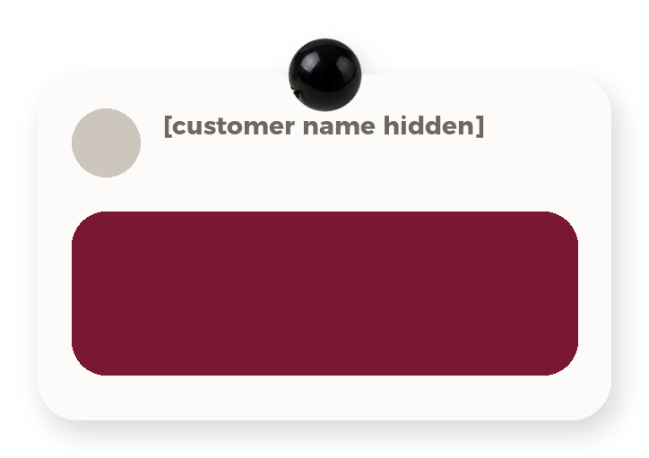
you asked
[the question your
customer asked]
Everything blue is a guide. Delete it before you download.
Notes:
Slide 1. Hook. Swap in a photo of your product. Type the question a customer asked you.

Slide 2

[can I wash it?]
[here's the answer]
Notes:
Slide 2. Second hook: Instagram often shows a carousel starting on slide 2, so this one works as a cover on its own. No photo needed. Edit both [bracket] lines.

Slide 3


the answer
[in one line]
Notes:
Slide 3. Swap in a photo that shows the answer. Edit the line.

Slide 4



[yes! wash
it at 30°]
Notes:
Slide 4. The answer on a note, a photo pinned beside it. Edit the note.

Slide 5


[the answer,
line two]
Notes:
Slide 5. A second answer photo, then the second line of your answer.

Slide 6
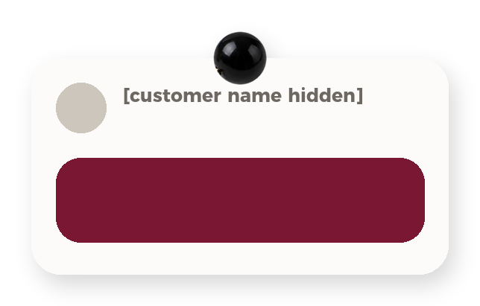
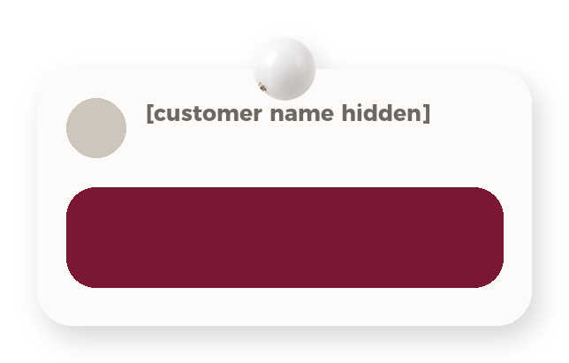
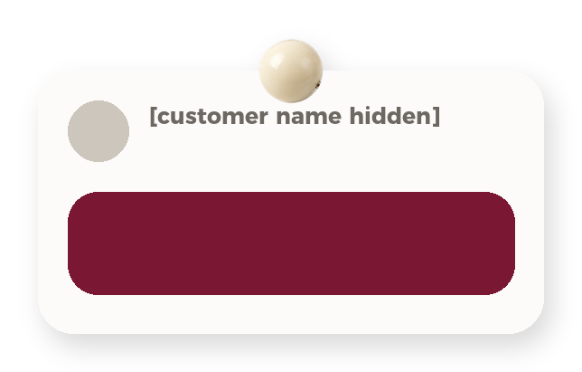

you all asked:
[another question]
[and another]
[one more]
Notes:
Slide 6. More questions you get. One per card.

Slide 7


[one tip for
using it]
Notes:
Slide 7. Your product in use. Edit the line.

Slide 8


Comment
"[KEYWORD]"
[more questions?]
Notes:
Slide 8. Swap in a photo of your product. Type your keyword. Caption to start from (CTA in the first two sentences, 3 hashtags): Comment [KEYWORD] and I will send you [the link]. [One line of real context: who it helps or how you use it.] #[tag] #[tag] #[tag]

